Slide 1



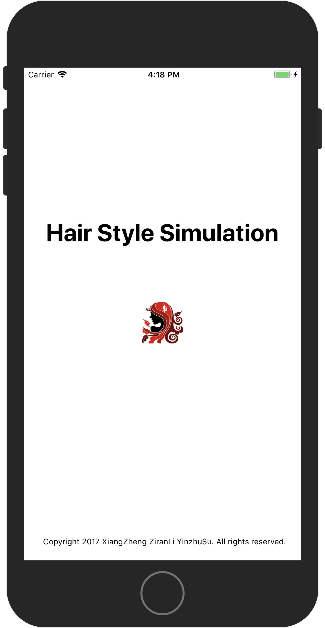
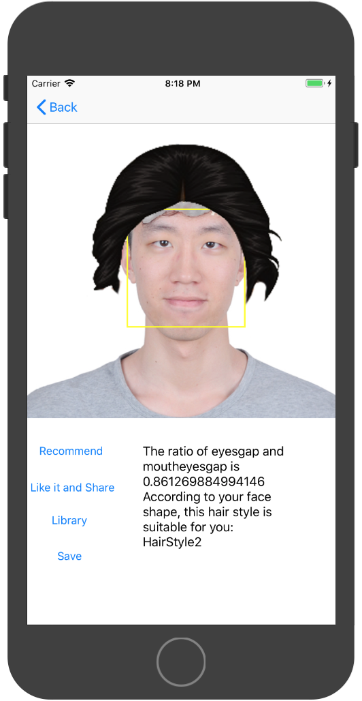
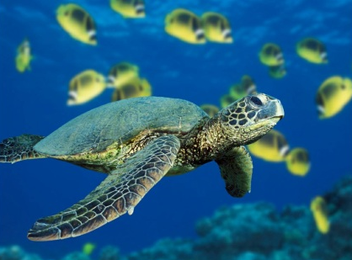
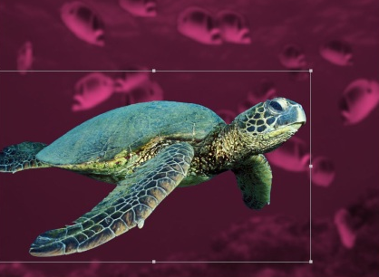
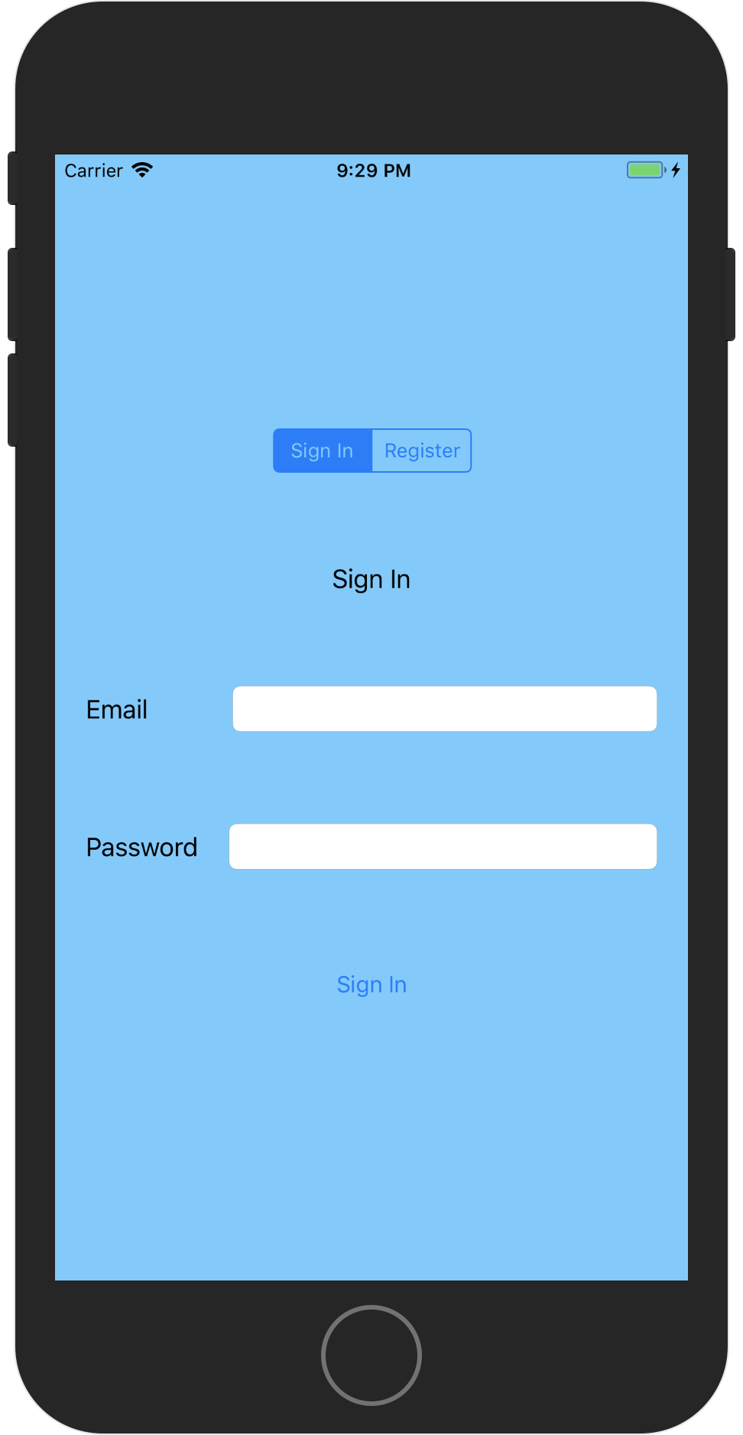
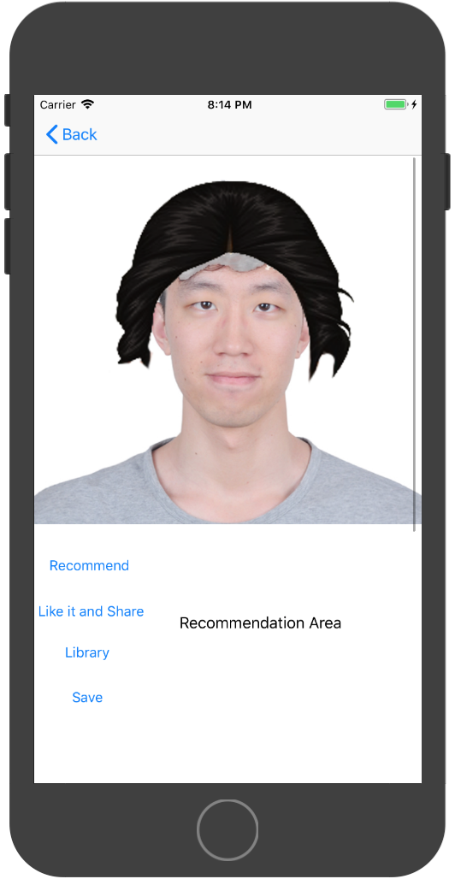
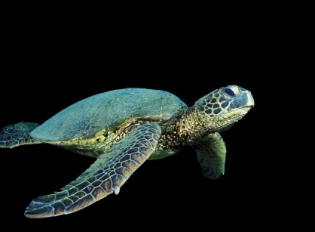
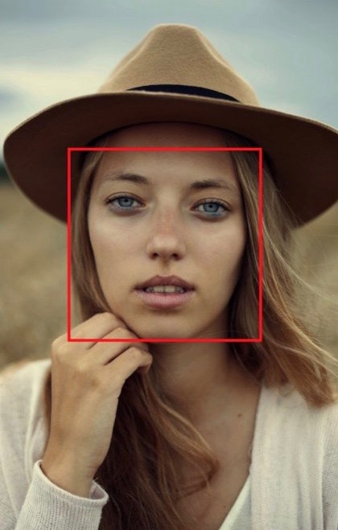
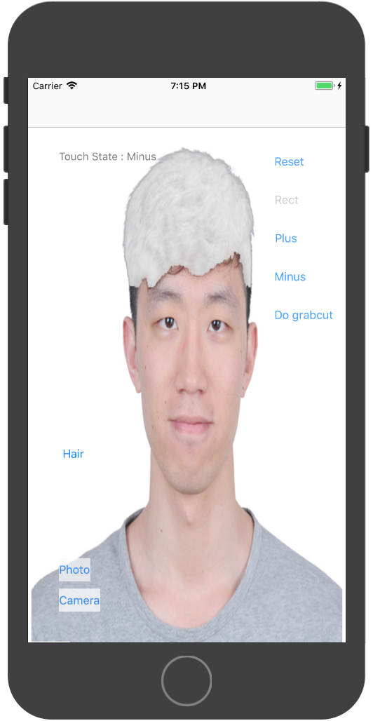
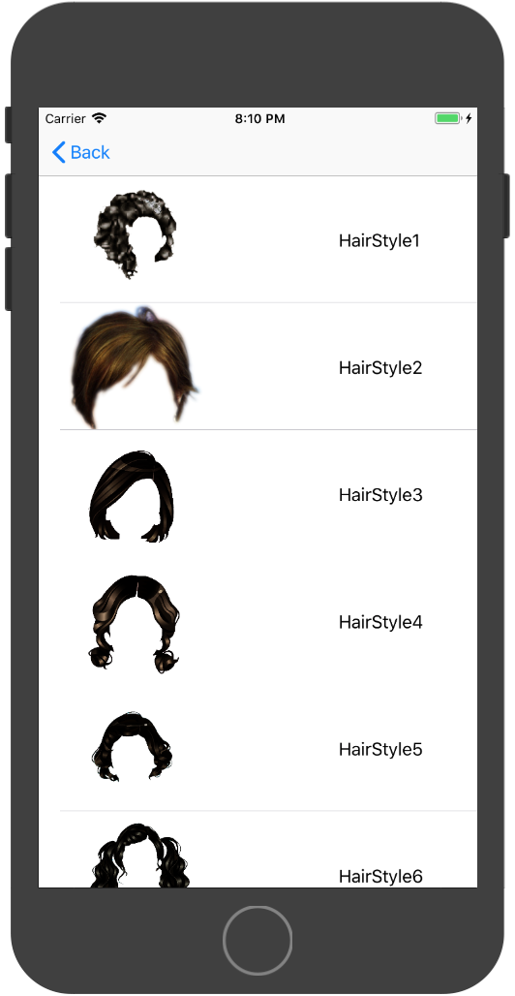
HAIR STYLE SIMULATION
Xiang Zheng Ziran Li Yinzhu Su
Department of Electrical& Computer Engineering Boston University
zhengx95@bu.edu zrli@bu.edu yzsu@bu.edu
Github
Trello
Introduction
Core Technology
Recommendation
iOS application
Detect human hair part with user interaction
Remove the old one, try new hairstyles on!
Core Image algorithm
Based on the data of face, give hairstyle recommendation
GrabCut
GrabCut is an image segmentation method based on graph cuts.
Starting with a user-specified bounding box around the object to be segmented, GrabCut estimates the color distribution of the target object and that of the background using a Gaussian mixture model. This is used to construct a Markov random field over the pixel labels, with an energy function that prefers connected regions having the same label, and running a graph cut based optimization to infer their values. As this estimate is likely to be more accurate than the original, taken from the bounding box, this two-step procedure is repeated until convergence.
Estimates can be further corrected by the user by pointing out misclassified regions and rerunning the optimization. The method preserve edges.
Firebase
Match Your Face
Register with email
Already registered? Sign in!
Google Firebase
Hairstyle matching
Move manually
Zoom in and Zoom out
CoreImage
CoreImage is an image processing and analysis technology that provides high-performance processing for still and video images. Use the many built-in image filters to process images and build complex effects by chaining filters. For details, see Core Image Filter Reference. Developer can also create new effects with custom filters and image processors; see Core Image Programming Guide.
In our Hair Style Simulation, we mainly use CoreImage to detect human’s face, and send more detail information, such as eyes’ position and mouth’s position on the picture, to the backend part of the app, to calculate the user’s head shape so that our app can give the user recommendations hairstyle according to his/her head shape.
GrabCut
Select Hairstyles
GrabCut algorithm
Interactive Foreground Extraction
Hairstyle selection
10 hairstyles till now
这个区域可以分成两半，分别写User Story 和 Accomplishment，反正整个海报看起来左右对称就行

